Slide 1
Module Cleaning Techniques for Solar Modules
Presented By:
NANO CERAMIC 9H
www.Nanoceramic-9H.com

Slide 2
Cleaning Techniques using Warranty friendly Approach
Panel warranties are of two types: A) Product Warranty and B) Performance Warranty.
The tags / labels put on Panels by the Manufacturer should be protected.
The Cleaning methods adopted should not damage to the original design and the Materials used for Panels.
Use of Corrosive Materials like using Acid / Vinegar should be avoided.
The cleaning team should avoid stepping directly onto the panels.
Techniques where we can save water and resources to clean the Solar Plants are preferable.
TDS of water which we are using to clean the solar panels should be around 70. If it is higher, one can use techniques to soften the water.
Manual Cleaning methods with adequate tools like Water Fed Brush is an easy way to keep Solar plants Clean. This is cost effective as well.

Slide 3
Cleaning Techniques using Warranty friendly Approach…. Way forward
Anti Soiling coatings like Super Hydrophobic coatings can make cleaning task easy and efficient. The coating does not react with or change any part of the panel.
Robotic cleaning is a good option if you don’t have to make any change to the mounting structures.
Electrodynamic Screen is not adopted widely as of now. It is in development phase and cost may be high.
Sprinkler system can be a good option if coupled with Anti Soiling coatings. This will cause water draining off the panels quickly.
We shall briefly review various types of challenges faced by Solar Professionals while cleaning the Solar Plants in Tropical Climate.

Slide 4
Industrial Dust
All kinds of dust can get accumulated on the solar panels. It depends of the Geographical location. The accumulation of any dust causes obstruction for the Sunrays falling on the cells. However the light gets absorbed by the dust particles causing temperature of the solar panel to go up. Broadly, the following type of dusts are commonly faced:
Metal Dust
Chemical Dust
Salt Layer
Rubber dust
Carbon dust
Cement dust
Rice Mill Dust
Dust from Surrounding Industries
Cotton Dust
Coal Ash Dust

Slide 5
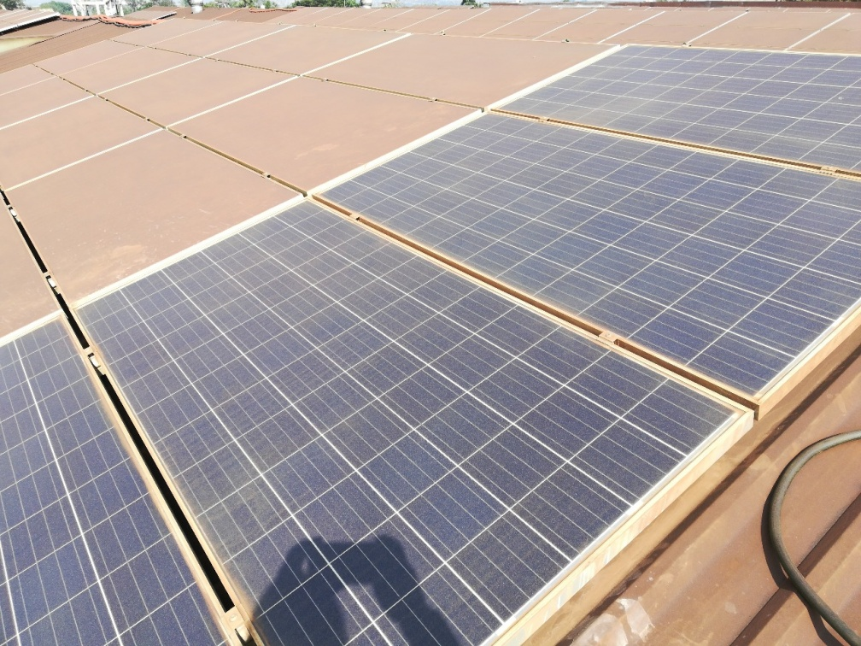
Various type of dust that get accumulated on Solar Panels – Metal Dust
NANO CERAMIC 9H
NANO CERAMIC 9H
Metal Dust problem is faced when the plant is located near a Metal foundry. The
Metal Dust is an issue for solar plants in the vicinity of Metal foundry. The above plant suffered from the Copper Dust. Location is Chennai.
The Copper Layer bonding is so thick that the transmittance of the panel reduced to negligible. This problem can be solved with planned cleaning strategy.

Slide 6
Various type of dust that get accumulated on Solar Panels – Metal Dust
NANO CERAMIC 9H
NANO CERAMIC 9H
NANO CERAMIC 9H
The plant is located in the vicinity of Aluminum factory.
Age of the plant is 18 months when the snap was taken.
The Aluminium dust caused reduction by 40% in generation of the plant.

Slide 7
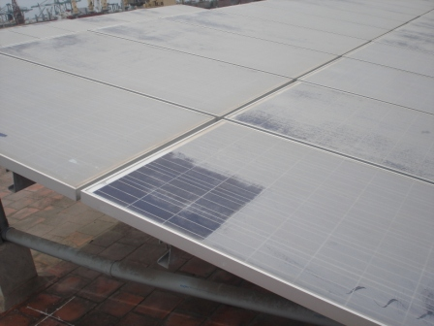
Various type of dust that get accumulated on Solar Panels – Chemical Dust / Salt coat
NANO CERAMIC 9H
NANO CERAMIC 9H
The Chemical / salt accumulation problem at Chennai. Layer of 1 to 2 mm thickness deposited in 22 days.
The Hydrophobic coating resolved the problem and the plant now performs normally.

Slide 8
Other causes of generation drops (Nature related soiling Clauses)
Hard water marks or scaling: Salt marks appear on the panels after washing.
Bird droppings : These are also unavoidable especially in Tropical Climate
Insect droppings: The yellow marks that appear on panels.
Pollen and Algae : These appear on solar panels located in fields or farms.
Bonding: The accumulated particles stick to the Panel glass. They start building deposits. Over the period it becomes strong and can not be easily removed. This is known as formation of bonding on the Panel surface.

Slide 9
Other dirt that get accumulated on Solar Panels – Hard water Marks
TDS of water used for cleaning solar panels is 70. Practically, TDS of available water is way more.
The RO Water has TDS around 150, which is still acceptable.
If it is more, we face the problem of Hard water marks.

Slide 10
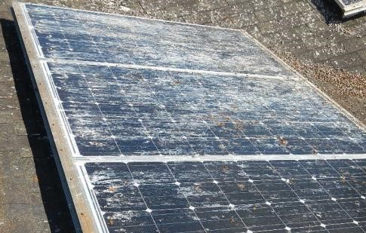
Other dirt that get accumulated on Solar Panels – Bird Droppings
This is Universal problem for all plants across India.
The bird droppings if not cleaned timely can cause hot spots
The effort to clean the panels increases as it sticks to the panel surface and forms bonding.

Slide 11
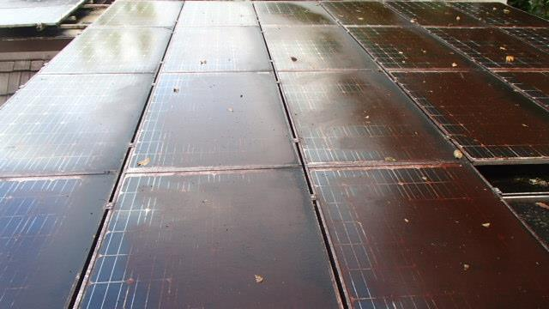
Other dirt that get accumulated on Solar Panels – Algae
This is Universal problem for all plants located in farms.
If water gets accumulated on panels, Algae is developed.
The effort to clean the panels increases as it sticks to the panel surface and forms bonding.

Slide 12
Cleaning Methods Deployed in Industry
At present following methods are used for cleaning of the Glass Panels.
1. Manual Cleaning + Handy tools with Water
2. Manual Cleaning + Handy Tools with RO Water
3. Manual Cleaning + Handy Tools with Corrosive liquids ( Cleaning Methods deployed in industry: Vinegar, Hydrochloric Acid, Harpic, etc.)
4. Sprinkler System
5. Cleaning with High pressure water jet
6. Anti Soiling Coatings :
i) Hydrophilic Coatings
ii) Hydrophobic Coatings
7. Robotic Cleaning
8. Electrodynamic Screen (Still in development stage.)

Slide 13
Solar Panel Cleaning: Manual Cleaning + Handy tools with Water
The most widely used method.
Effective to some extent
Consumption of water can not be measured / controlled.
Not effective to remove bonding formed on the surface of the panels.

Slide 14
Solar Panel Cleaning: Manual Cleaning + Handy Tools with RO Water
Effective to some extent
Usage of water consumed can not be measured / controlled.
Not effective to remove bonding formed on the surface of the panels.
Maintenance of RO Plant is expensive. Hence water used to clean costs more than normal water.

Slide 15
Solar Panel Cleaning – Manual Cleaning + Handy Tools (Water Fed Brush)
This method uses a Water fed Extendable brush to clean the solar panels.
Satisfactory Results
This method is gaining Popularity.
It can withstand 4 to 5 bar pressure easily.
The bristles of the brush (S5/S6 type) are gentle on glass, yet they can remove dirt.
NANO CERAMIC 9H

Slide 16
Solar Panel Cleaning – Manual Cleaning + Handy Tools (Sleeve with Washer mounted on Telescopic Pole)
This method uses a Telescopic Pole to clean the solar panels.
Wet Microfiber washer with sleeve is mounted on the pole to clean the panels .
This method is gaining Popularity.
Microfiber sleeve is soft on panels but removes the dirt.
NANO CERAMIC 9H
NANO CERAMIC 9H

Slide 17
Solar Panel Cleaning: Manual Cleaning + Handy Tools with Corrosive Liquids
Effective to some extent
Water has to be used to wash these liquids away from the panels
The team on ground may not be qualified enough to use it for Solar Panels.
The panels might get their glass etched.
Might affect frame and sealant

Slide 18
Solar Panel Cleaning – Sprinkler System
This method uses Water Sprinklers to clean the solar panels.
Results are satisfactory.
May not be suitable to remove bonding on the panels.
It is recommended to make sure that the panels are completely dried after the sprinkler is shut down.
If Panels are coated with Anti Soiling coatings, it helps best to make them dry.
Image Courtesy: Heliotix

Slide 19
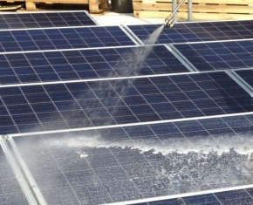
Solar Panel Cleaning: Cleaning with High Pressure Water Jet
The water pressure should not exceed 4 to 5 bars.
Light bonding on Glass surface gets removed.
High pressure of the jet might damage the glass of the Panels.
The team on ground may not be qualified enough to use it.
Consumption of water can not be controlled.

Slide 20
Solar Panel Cleaning – Anti Soiling Coatings (Hydrophilic)
HYDROPHILIC COATINGS
Contact angle of Hydrophilic coatings is less than 30 Degrees.
The dust particles accumulate on the Hydrophilic / Super Hydrophilic coatings.
Water enters underneath the dust particles.
Hence it can take the dirt / dust particles away when it flows.

Slide 21
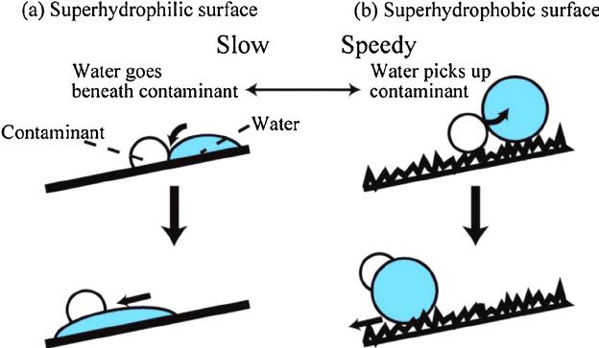
Solar Panel Cleaning – Anti Soiling Coatings (Hydrophobic)
HYDROPHOBIC COATINGS
Hydrophobic surface makes the contact angle high.
This causes water to roll down the surface.
Hence dust can not stick to the panel surface and can not form bonding.
This results in clean surface with minimum usage of water.

Slide 22
Solar Panel Cleaning – Robotics
NANO CERAMIC 9H
Robotic cleaning is ideal for large solar plants.
It is efficient way to clean the solar plants.
It may not prove to be cost effective for small solar plants.

Slide 23
Solar Panel Cleaning – Electrodynamic Screen
Electrodynamic Screen is the latest technology.
Thin transparent sheet consisting of Electrodes is laid on the panels.
The electrodes charged in phases repel the dust particles.
Saves water required for cleaning
As of now the costs are on the higher side.

Slide 24
Solar Panel Cleaning – Water Consumption Analysis
Assume a Solar Plant size of 21kW, having 70 panels of 300 W each. Analysis of Water usage and Cleaning time (with 2 labours) with various methods is as shown in the table:
Sr. No. | Method of Cleaning | Water Usage | Cleaning Time (Hours)
1 | Manual Cleaning + Handy Tools | 420 Liters | 6 to 7
2 | Manual Cleaning + Water Fed Brush / Washer and Sleeve | 140 Liters | 3 to 4
3 | Manual Cleaning + Handy Tools (Corrosive Liquids) | 420 Liters | 6 to 7
4 | Sprinkler System | 210 Liters | 2 to 3
5 | Cleaning with High pressure water jet | 490 Liters | 2 to 3
6 | Hydrophilic Coating | 140 Liters | 2 to 3
7 | Hydrophobic coating | 70 Liters | 2
8 | Robotic Cleaning | 55 Liters | 10 minutes
9 | Electrodynamic Screen | Nil | 10 to 15 minutes

Slide 25
NANO CERAMIC 9H ….. Your Cleaning Partner on Field !
NANO CERAMIC 9H focus specially on the Solar Panel Cleaning problems.
We have earned expertise over years by visiting hundreds of Solar plants and analyzing and solving problems on ground.
We help you to restore your old solar plants if you have generation problems due to cleaning related issues.
We give cleaning solutions to Small Household Rooftop plants, Medium size plants and Mega size plants as well.
Effectively resolved issues related to the Metal Dust, Chemical Dust, rice mill dust, cement dust, rubber dust, Coal ash dust, soiling, etc.
Our solutions are practical, cost effective and long lasting.
We have been operational since 2015 and have successful track record in every geographical area.
Our core areas of expertise include Super Hydrophobic solutions, Water Fed Brush, Cleaning tools, Rooftop kits of cleaning (For old and New solar plants), Robotic solutions.
Testing of our Hydrophobic solution has been done by the IIT Bombay, Lubi Electronics, PV Powertech.
Range of Happy customers include Loyola College, Chennai, Amritha Vishwavidyapeetham, Kerala

Slide 26
Questions & Answers
Visit our website : www.nanoceramic-9h.com
For any queries related to cleaning problems, please contact us: Sales@nanoceramic-9h.com
Nano Ceramic 9H - Mumbai
Nano Ceramic 9H – Chennai
Nano Ceramic 9H - Delhi
Nano Ceramic 9H - Bangalore
Proud to be Associated with Service Enablers :
Infirencon Energy Pvt. Ltd., Nashik
Amrohi Technologies Pvt. Ltd., Sangli
Four Point Energy Ventures., Delhi NCR Region
Deepak Poche | 9324012933 | deepak.poche@nanoceramic-9h.com
Amit Joshi | 9892373372 | amit.joshi@nanoceramic-9h.com
Ravi K.S. | 9677271996 | raviks@nanoceramic-9h.com

